Slide 1
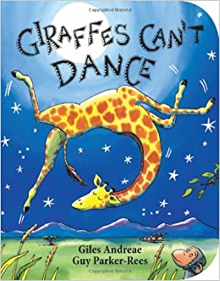
This weeks ‘Giraffes Can’t Dance’ inspired challenges are…

Slide 2
Challenge 1
Lets have a jungle dance! Can you find some music that you love and have a jungle dance at home? Try moving in different ways like skipping, swaying, leaping, twirling just like the animals in the story.

Slide 3
Challenge 2
Lets make some jungle play dough! Try making some play dough using the recipe that Miss Taylor gave you or maybe try this simple recipe; 8 tbsp flour 2 tbsp salt 60 ml warm water Food colouring 1 tbsp vegetable oil. Mix everything together in a bowl and then knead until soft. Have a look in your garden for some leaves, twigs, grass or anything you can find that you might see in the jungle. Have you got any animals that you could add to your play dough and create a jungle scene? (Grown ups I have attached a picture to help in the documents)

Slide 4
Challenge 3
Did you notice that the story was a rhyming book? Can you find 2 things in your house that sound the same? I found a hat and a bat in my house!

Slide 5
Challenge 4
Have a look at some pictures of the animals in the story. Can you make a model of one of the animals? You could use some junk modelling or play dough or anything you like.

Slide 6
Challenge 5
Have a go at making a banana giraffe! Cut a banana in half and use some melted chocolate or chocolate raisins or seeds or whatever you like to create a banana giraffe! (Grown ups I have attached a picture to help in the documents or YouTube has a good tutorial 'funny banana giraffe/creative food’)

Slide 7
If you complete 2 of our super challenges you will receive a bronze superstar certificate.
If you complete 3 of our super challenges you will receive a silver superstar certificate.
If you complete 4 of our super challenges you will receive a gold superstar certificate.
If you complete 5 of our super challenges you will receive a rainbow superstar certificate.

Slide 8
We will be reading a new story next Friday accompanied by new super challenges for you to complete.
Please upload these onto Tapestry so we can see what super learners you are being at home. We hope you have lots of fun completing these!
Love from Mrs Evans

